Slide 1
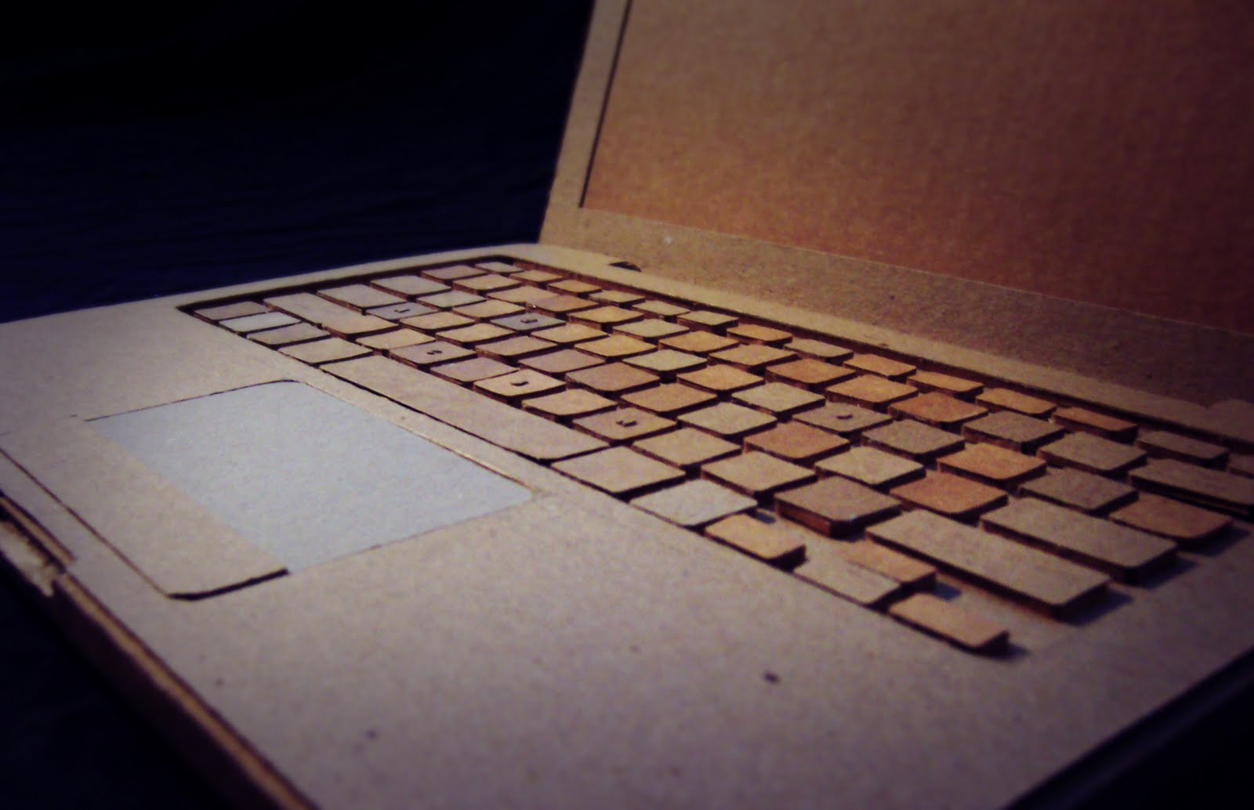
Digital Doctor for pneumonia
Your health assistant

Slide 2


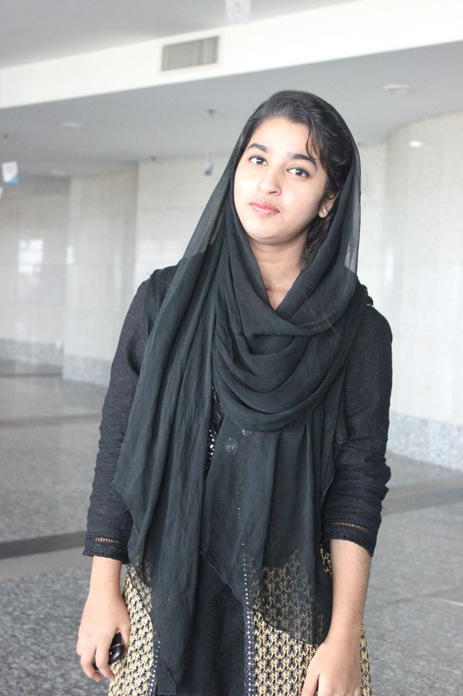
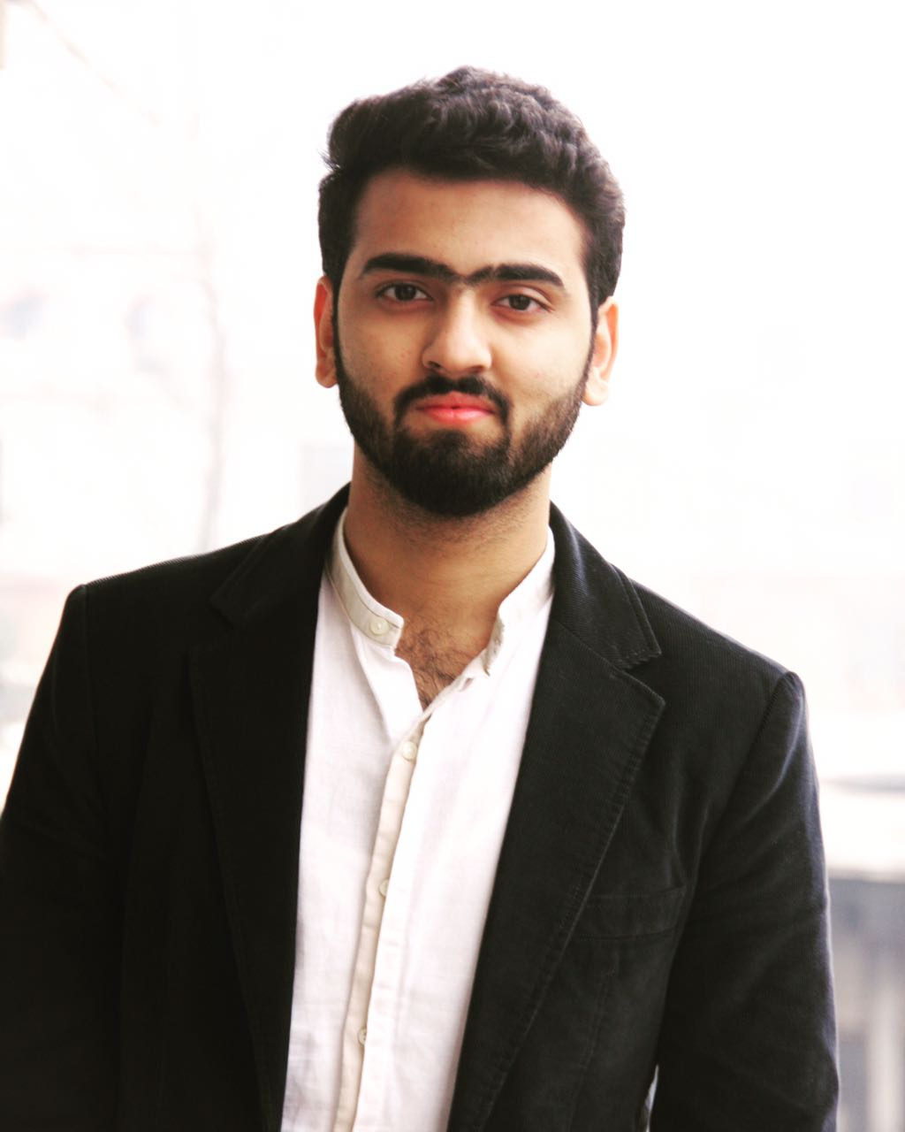
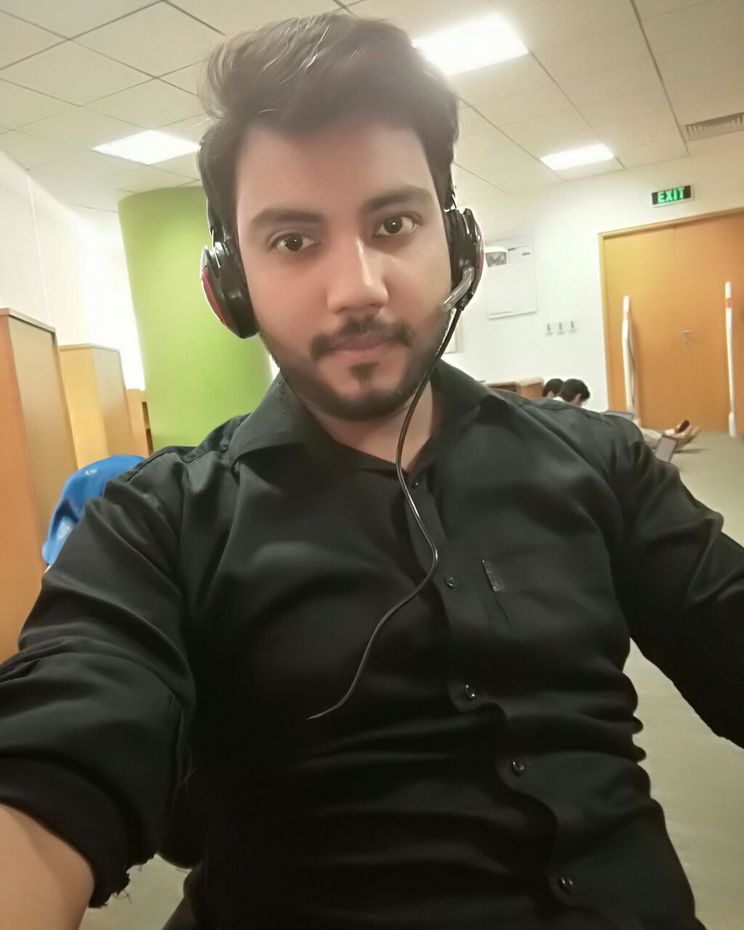
Our Team
Aaira Suhail
Iqra Shahzad
Shehyar Zahid
Syed M.Hasan

Slide 3
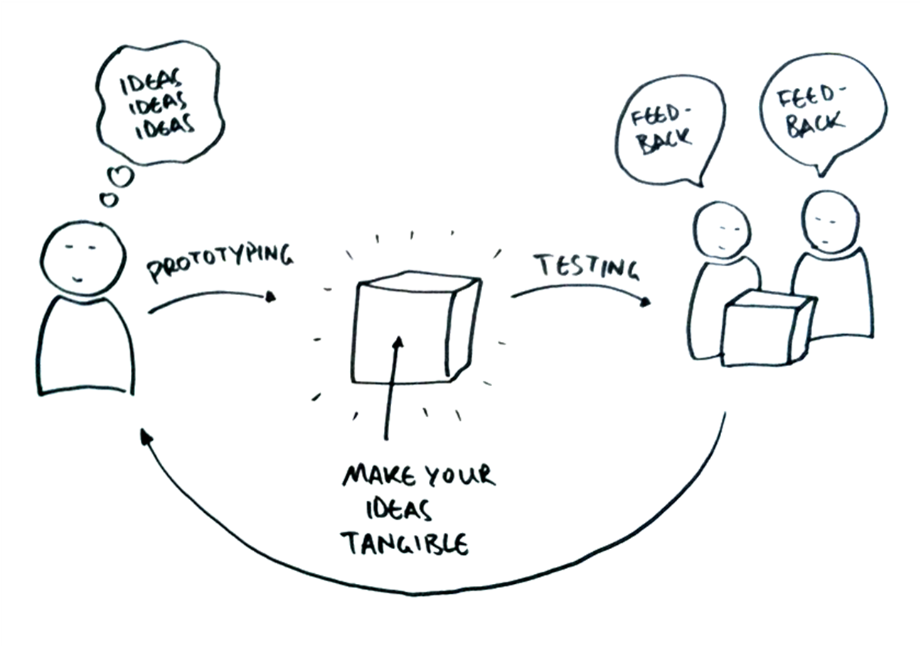

Slide 4
Overview
Who are we?
What did we design?
What did we learn from User Testing?

Slide 5
Digital Doctor
Our Mission: To provide ease to patients so that they can detect pneumonia at homes by themselves.

Slide 6
Digital Doctor for pneumonia
Goals
Diagnose pneumonia
Reduce visits to doctors
Save diagnoses time

Slide 7
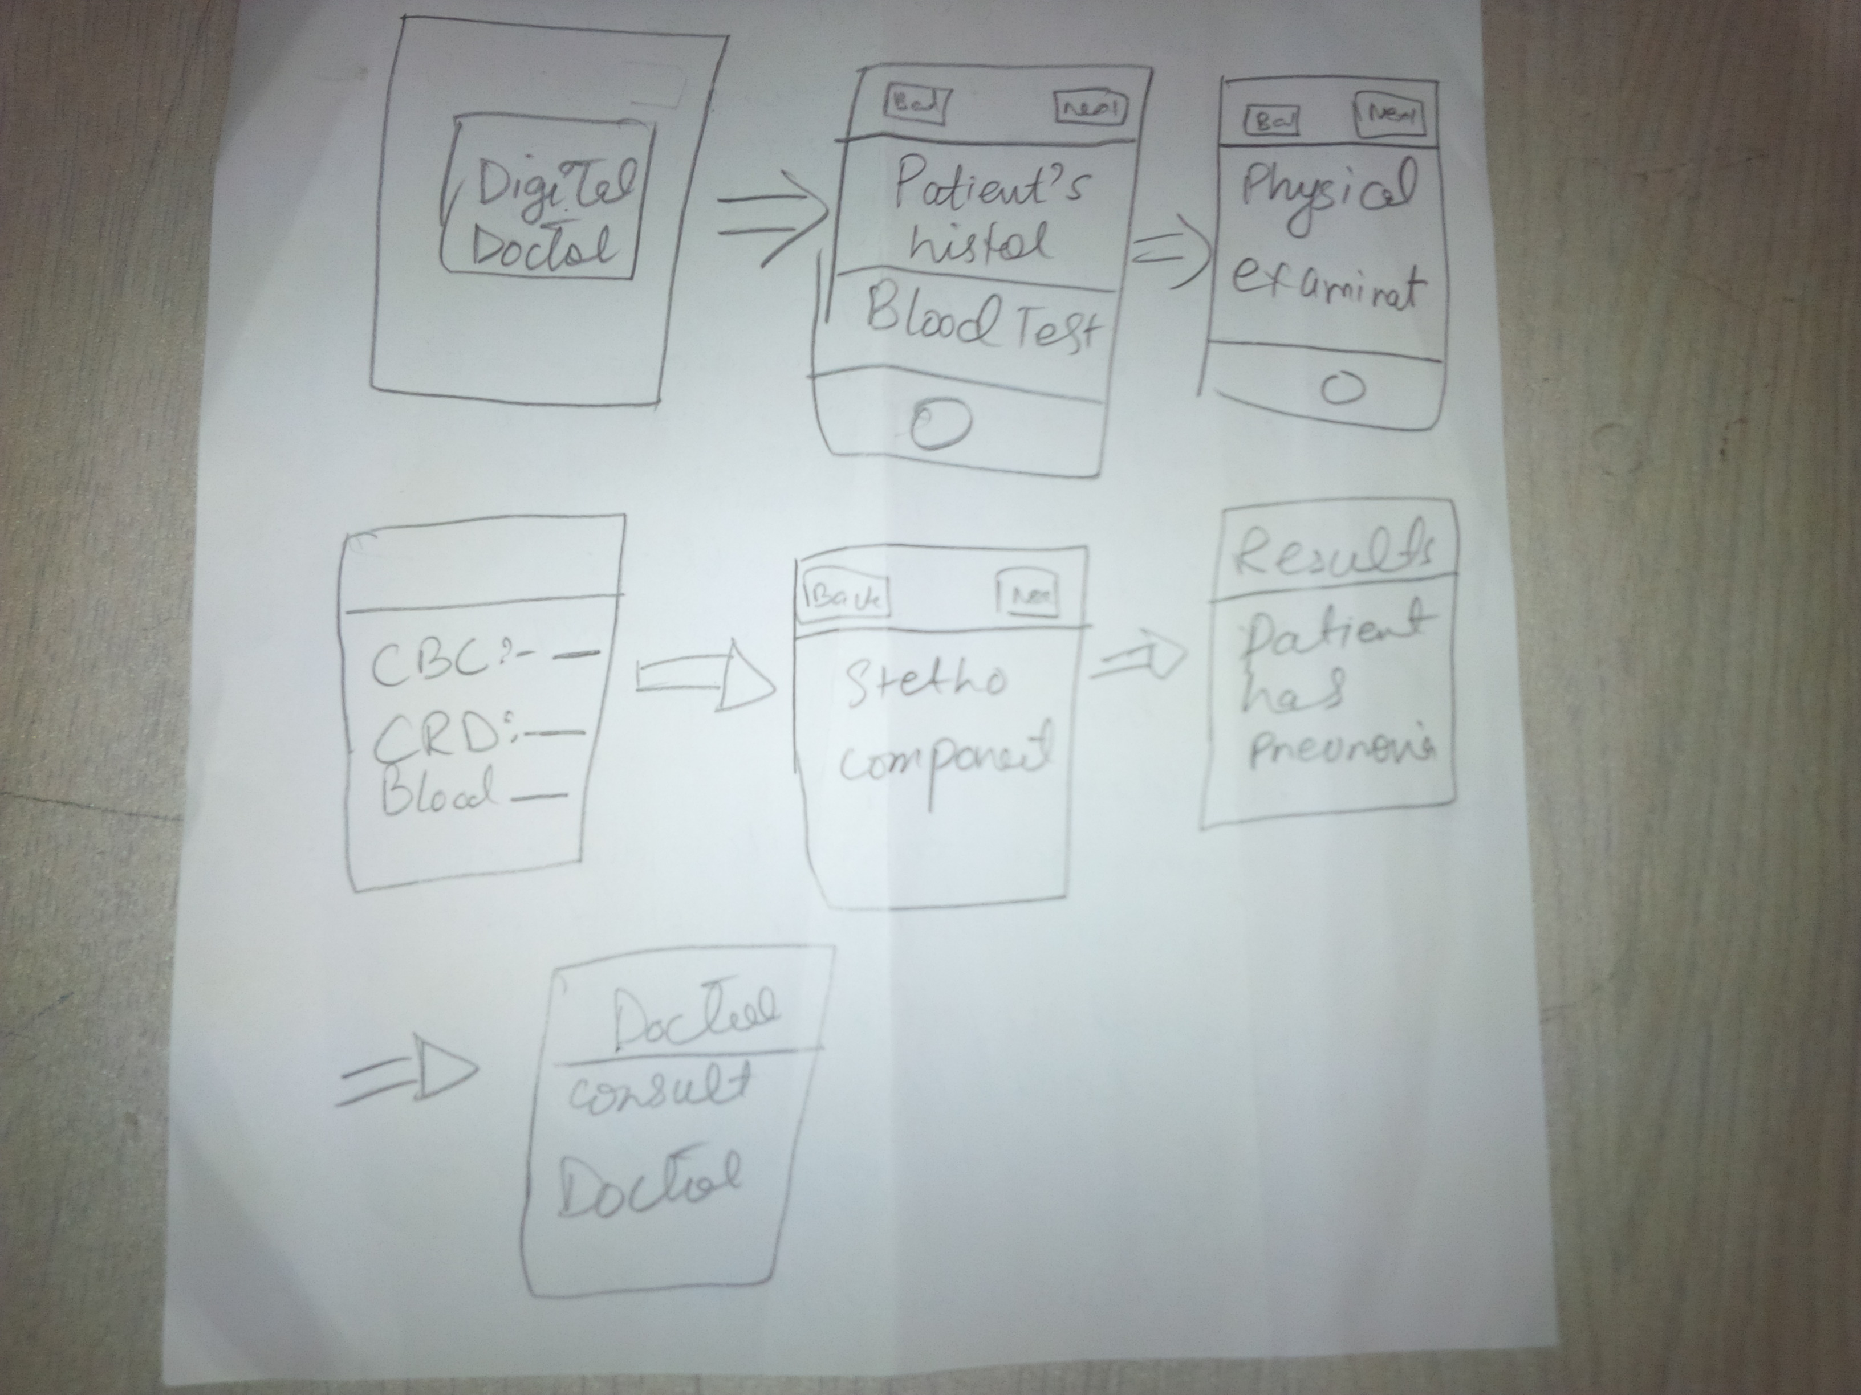
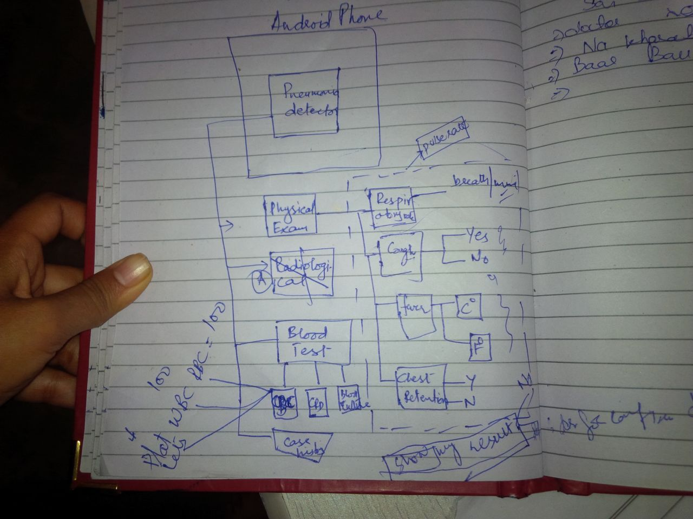
Initial sketches

Slide 8
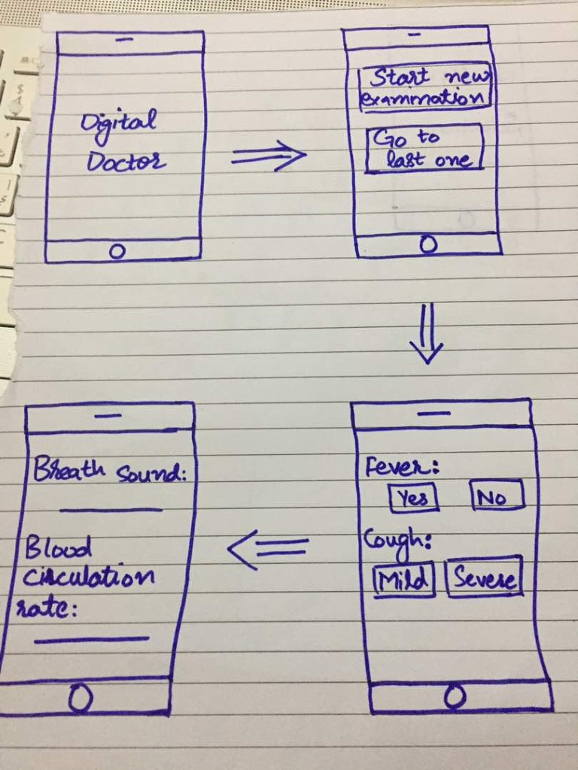
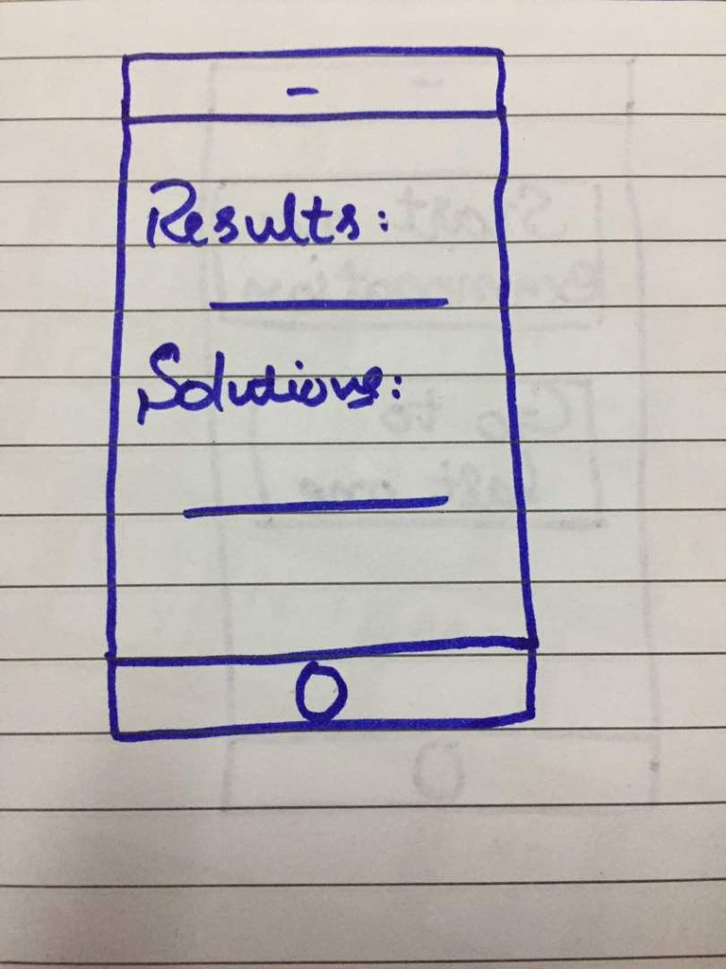
1st Prototype:

Slide 9
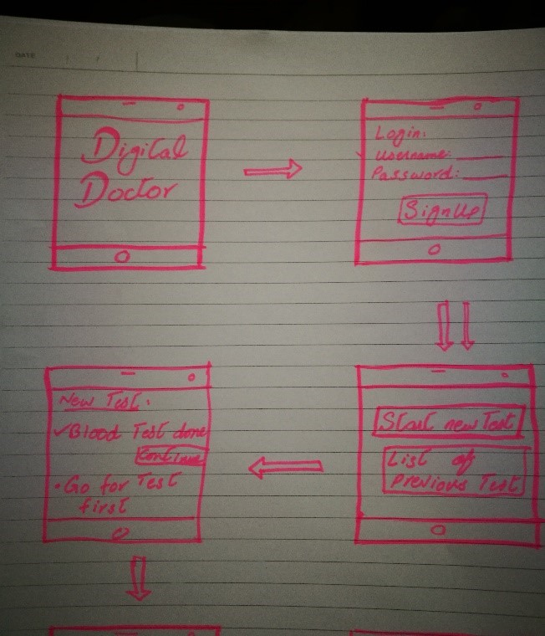
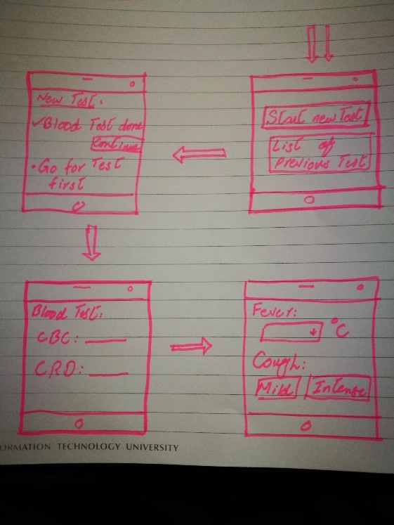
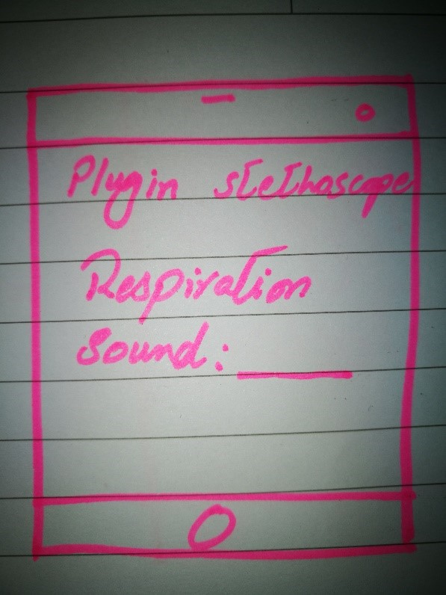
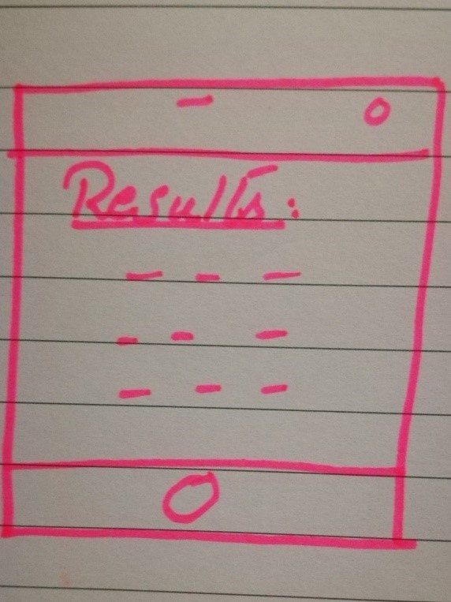
2nd Prototype:

Slide 10
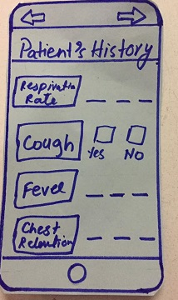
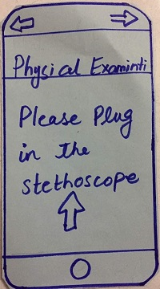
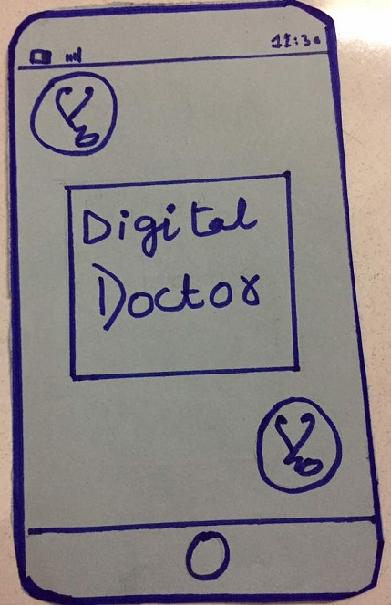
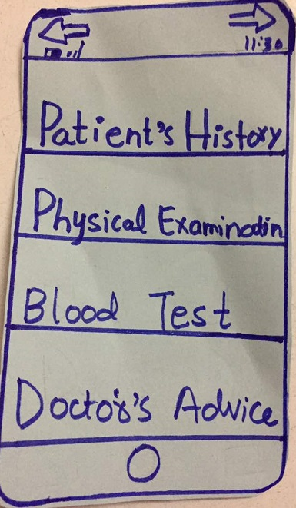
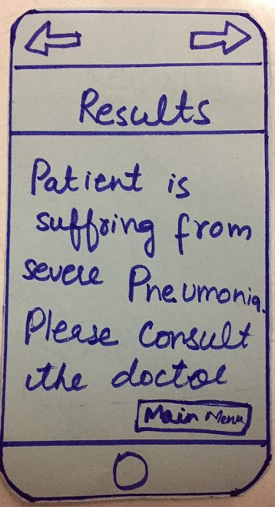
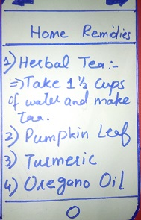
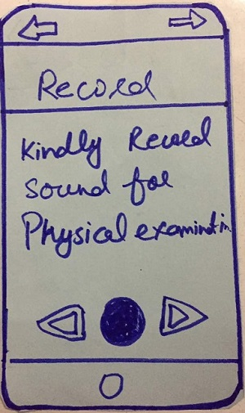
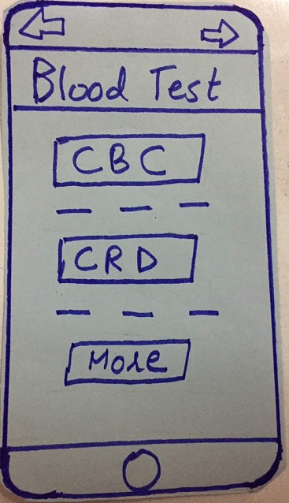
3rd Prototype:

Slide 11
Digital Doctor for pneumonia
Testing
Rubina Raza (housewife)
Parveen bibi (mother of a child suffering from pneumonia)
Lady who was suffering from pneumonia

Slide 12
Digital Doctor for pneumonia
Results
Third prototype is our best prototype because it is easy to use and detailed one.

Slide 14
Summary
Who are we? Digital Doctor for pneumonia
What did we design? An Application for patients
What did we learn from User Testing? The app is generally easy to use and have good interface but there is a trust factor.

Slide 15
Thank you!

